Slide 1
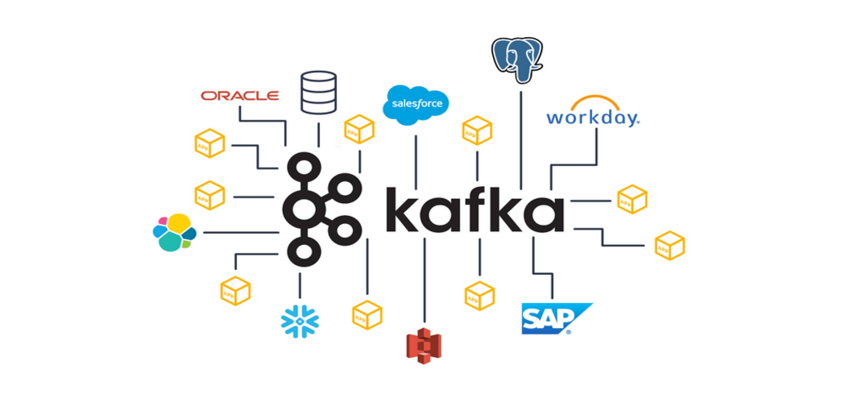
APPACHE KAFKA
Presented by :
SHIZA IMRAN (MSDSF23M002)
Maham Asif (MSDSF23M015)

Slide 2

Introduction
Architecture
Kafka Features
Kafka Cluster
Zookeeper
Kafka Topic and Partition
Consumer Group
Topic Creation
Producer Creation
Consumer Creation
Environment Setup In Java
Kafka Use Case
Conclusion
.

Slide 3

INTRODUCTION
Kafka is a unique distributed message streaming platform that uses publish and subscribe mechanism to stream the records and runs on Java Virtual Machine (JVM).
Originally developed by LinkedIn and later donated to Apache foundation.
Kafka is a open source.
Currently used by many big enterprise like LinkedIn, Netflix, Uber, Walmart, Airbnb

Slide 4
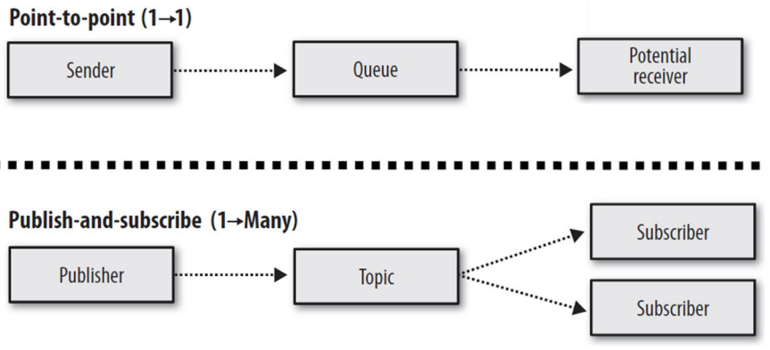
Messaging System
A messaging system is responsible for transferring data from one application to another so the application can focus on data without getting bogged down on data transmission and sharing.
Two Types:
Point To Point messaging system
Publish-Subscribe Messaging system
Notes:
Point to Point: Messages are persisted in a queue. A particular message can be consumed by maximum of one receiver only. There is no time dependency laid for the receiver to receive the message. When the receiver receives the message it sends acknowledgment back to the sender.
Publish Subscribe: Messages are persisted in a topic.A particular message can be consumed by any number of consumers.There is time dependency laid for the consumer to consume the message.When the subscriber receives the message it doesn’t send an acknowledgment back to the publisher.

Slide 5
Key Terminologies
Topic: A stream of message belonging to particular category. Unique Identifier is its Name.
Partitions: Topics are split into Partitions. All the messages within a petition are ordered and unmuttable.
Producers: They are applications which write/publish data to the topics within a cluster using ProducingAPIs. The write can either be on topic level or specific partition of the topic.

Slide 6
Key Terminologies
Consumers: They are applicants which read/consume data from topics within a cluster using Consumings APIs. They are always associated with exactly one Consumers Group.
Brokers: They are simple software processes who maintain and manage the publish messages. Also known as Kafka Server.
Zookeeper: It is used to monitor kafka Cluster and coordinate with each broker.Keep all metadata info related to kafka cluster in the form of key-value pair.

Slide 7
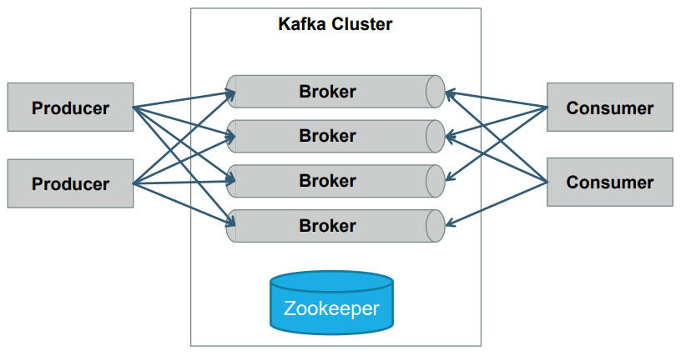
ARCHITECTURE

Slide 8
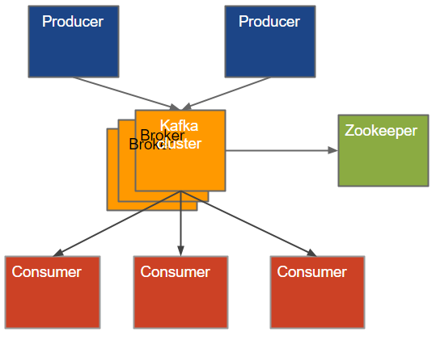
KAFKA CLUSTER
Cluster is basically a group of computers or servers that are working for a common purpose.
As, Kafka is distributed system it can have multiple kafka servers or brokers inside a kafka cluster. So there can be more than one kafka brokers inside a single kafka cluster.
Notes:
Suppose producer is publishing high volume of data than single kafka broker may not able to handle the load so might need to earn additional kafka servers or additional broker.Broker is decide on partition level.

Slide 9
KAFKA FEATURES
Performance: It has high throughput for both publish and subscribe messages.
No data loss: It ensure no data loss if properly configured.
Zero down time: It ensure zero down time when required no. of brokers are present in cluster.
Reliable: It is reliable because of above features.
Notes:
Kafka has high-throughput and is built to scale-out in a distributed model on multiple servers.

Slide 10
KAFKA FEATURES
Scalable: Horizontal scaling is done by adding new broker to existing cluster.
Fault Tolerance: Kafka cluster handle failure because of its distributed nature.
Durable: It uses “Distributed commit log” which means message persist on disk as fast as possible.
Notes:
Kafka has high-throughput and is built to scale-out in a distributed model on multiple servers.

Slide 11
Kafka Connect
The declarative, pluggable data integration framework for Kafka is called Kafka Connect. It is an open-source, free component of Apache Kafka that acts as a centralized data hub for simple data integration between file systems, databases, search indexes, and key-value stores.The Kafka distribution includes Kafka Connect by default. To install it, you just have to start a worker process.
Use the following command from the root Kafka directory to launch the Kafka Connect worker process:
.\bin\windows\connect-distributed.bat
.\config\connect-distributed.properties

Slide 12
Kafka Stream
Using Apache Kafka, developers may create robust stream-processing applications with the help of Kafka Streams. It offers APIs and a high-level Domain-Specific Language (DSL) for handling, converting, and evaluating continuous streams of data.
A key feature include:
Real-time processing of record streams is made possible by Kafka Streams. It enables you to take in data from Kafka topics, process and transform the data, and then return the processed information back to Kafka topics. Stream processing allows for near real-time analytics, monitoring, and data enrichment. It can be applied to individual recordings or to windowed aggregations.

Slide 13
ZOOKEEPER
Zookeeper is used to monitor kafka cluster and co-ordinate with each broker.
Keeps all the metadata information related to kafka cluster in the form of key-value pair.
Metadata includes:
Cluster information
Health status of each broker
It is used for the controller election within kafka cluster.
A set of zookeepers nodes working together to manage other distributed systems is known as Zookeeper cluster or zookeeper ensemble.

Slide 14
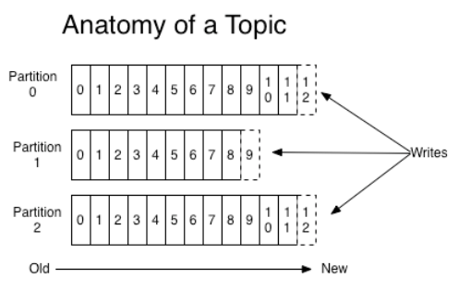
KAFKA TOPIC
Named container for similar events.
Unique identifier of a topic is its name.
They're like table in database.
They live inside a broker.
Producer produce a message into the topic or directly to partition.
Example:
Student topic have student related data.
Notes:
Send kafka msg with key or without. When data is send without key it will not be in order (round robin order). Key will apply hashing with data and decide to which partition data will go.

Slide 15
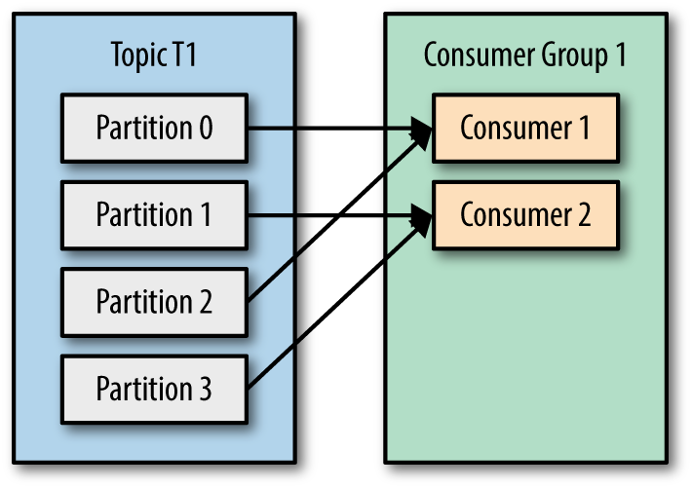
KAFKA PARTITION
A topic is split into several parts known as partitions of the topic.
Partition is where actually the message is located inside the topic.
While creating topic, we have to specify the number of partitions.
Each partition is an in-ordered sequence of records.
Each message get stored into the partition with an incremental id known as its offset value.

Slide 16
CONSUMER GROUP
Whenever create consumer in kafka cluster, ID is assigned to it, it means this consumer is belong to this consumer group
Consumer offset is a built-in topic in apache kafka that keep track of the latest offset committed for each partition of each consumer group.
Consumer offset
Position of a consumer in a specific partition of the topic. It represents latest message consumer have.
Consumer offset is a built-in topic in apache kafka that keep track of the latest offset committed for each partition of each consumer group.
Notes:
Consumer offset topic is used to store the current offset of each consumer in each partition for a given consumer group

Slide 17
Kafka Installation
It is often recommended that Apache Kafka is started with Zookeeper for optimum compatibility. Also, Kafka may run into several problems when installed on Windows because it’s not natively designed for use with this operating system. Consequently, it is advised to use the following to launch Apache Kafka on Windows:
WSL2 if you're running Windows 10 or later, or Docker
Docker If you're running Windows 8 or earlier
It is not advised to use the JVM to run Kafka on Windows since it does not have some of the POSIX characteristics that are unique to Linux. You will eventually encounter difficulties if you attempt to run Kafka on Windows without WSL2.

Slide 18
Kafka Environment Setup in JAVA
Step 1: Install WSL2
wsl --install
Step 2: Install Java
Step 3: Install Latest version of Appache kafka.
Step 4: Start Zookeeper
.\bin\windows\zookeeper-server-start.bat .\config\zookeeper.properties
Start 5: Start the Kafka server
.\bin\windows\kafka-server-start.bat .\config\server.properties

Slide 19
Kafka Environment Setup in Java
Step 6: Create a topic
.\bin\windows\kafka-topics.bat --create --topic MyFirstTopic --bootstrap-server localhost:9092
Step 7: Start Kafka Producer
.\bin\windows\kafka-console-producer.bat --topic MyFirstTopic --bootstrap-server localhost:9092
Step 8: Start Kafka consumer
.\bin\windows\kafka-console-consumer.bat --topic MyFirstTopic --from-beginning --bootstrap-server localhost:9092

Slide 20
TOPIC CREATION
Create Topic
kafka-topics --create --topic my_topic --bootstrap-server localhost:9092 --partitions 3 --replication-factor 2
List Topics
kafka-topics --list --bootstrap-server localhost:9092
Describe Topic
kafka-topics --describe --topic my_topic --bootstrap-server localhost:9092
Notes:
Replication factor 2 means topic has 2 copies. Let topic send msg to partition if it goes to broker 1 then msg will be replicated to broker 2. Here leader works.

Slide 21
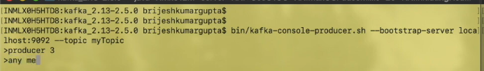
PRODUCER CREATION
Producer Creation
kafka-console-producer --topic my_topic --broker-list localhost:9092

Slide 22
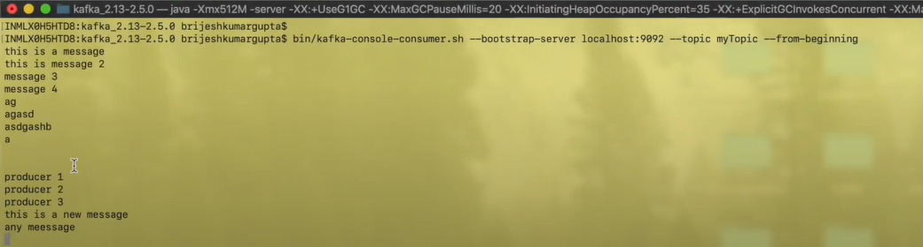
CONSUMER CREATION
Consumer Creation
kafka-console-consumer --topic my_topic --bootstrap-server localhost:9092 --from-beginning
Consumer Group
kafka-console-consumer --topic my_topic --bootstrap-server localhost:9092 --group my_consumer_group
Consumer Group Describe
kafka-consumer-groups --bootstrap-server localhost:9092 --describe --group my_consumer_group

Slide 23
Real-World Applications of Kafka
Notes:
Source https://kafka.apache.org/uses

Slide 24
Activity tracking
Kafka can be used by an online e-commerce platform to track user activity in real time. Every user action, including viewing products, adding items to carts, making purchases, leaving reviews, doing searches, and so on, may be published as an event to particular Kafka topics.
Other microservices can store or use these events for real-time fraud detection, reporting, personalized offers, and recommendations.

Slide 25
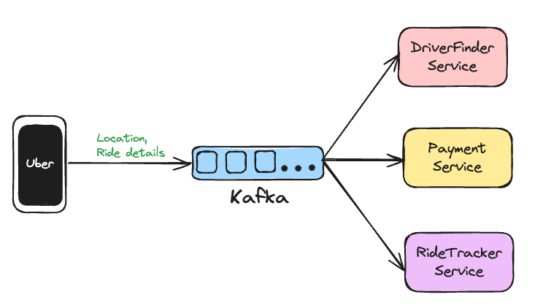
Messaging
With its improved throughput, built-in partitioning, replication, fault-tolerance, and scaling capabilities, Kafka is a good substitute for conventional message brokers.
For instance, the ride-booking business might use Kafka to communicate with the driver-matching service when a rider makes a reservation. The driver-matching service may then, in almost real time, locate a driver in the area and reply with a message.

Slide 26
Log aggregation
Typically, this entails obtaining physical log files from servers and storing them in a central location for processing, such as a file server or data lake. Kafka abstracts the data as a stream of messages and filters the file-specific information. This makes it possible to process data with reduced latency and to accommodate distributed data consumption and different data sources more easily.

Slide 27
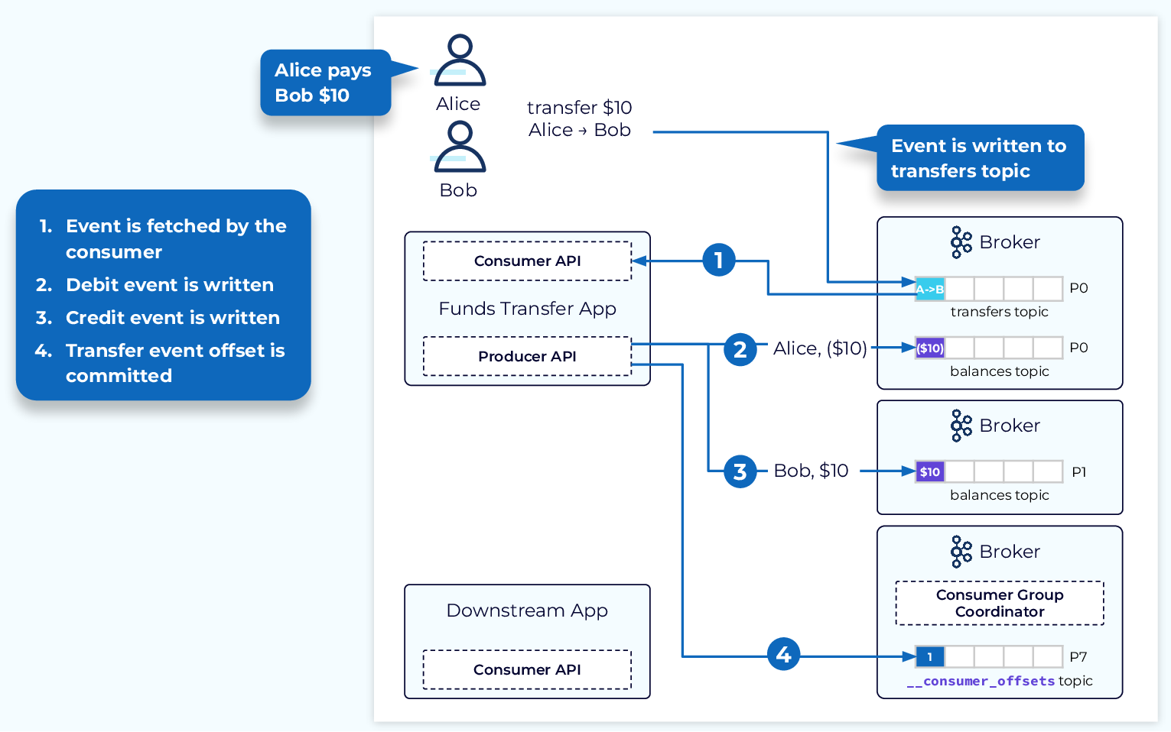
Stream processing
Several Kafka users process data in multi-stage processing pipelines. Raw input data is taken from Kafka topics, aggregated, enriched, or otherwise transformed into new topics for additional consumption or processing.
For example, a bank may use Kafka to process real-time transactions. Each transaction a customer starts is then posted to a Kafka topic as an event. Subsequently, an application may take in these events, verify and handle the transactions, stop dubious ones, and instantly update customer balances.

Slide 28
Metrics
Kafka could be used by a cloud service provider to aggregate statistics from distributed applications to generate real-time centralized streams of operational data. Metrics from hundreds of servers, such as CPU and memory consumption, request counts, error rates, etc., might be reported to Kafka. Monitoring applications might then use these metrics for anomaly identification, alerting, and real-time visualization.

Slide 29

CONCLUSION
When used in the right way and for the right use case, Kafka has unique attributes that make it a highly attractive option for data integration.
Kafka is a unique distributed publish-subscribe messaging system written in the Scala language with multi-language support and runs on the Java Virtual Machine (JVM).

Slide 30

THANK YOU!

